Slide 1
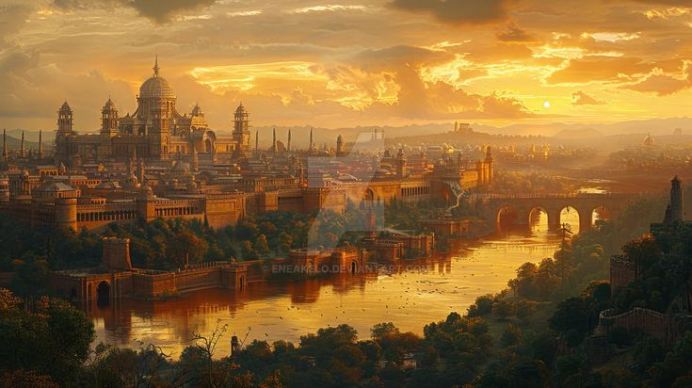

THE
ROMAN EMPIRE

Slide 2
The Roman Empire was one of the most powerful and influential civilizations in history. It began in 27 BCE when Augustus became the first emperor and expanded across Europe, North Africa, and the Middle East. The Romans built strong roads, cities, and monuments, and developed advanced systems of law and government that still influence the modern world. Latin was the main language, and Roman.

Slide 3
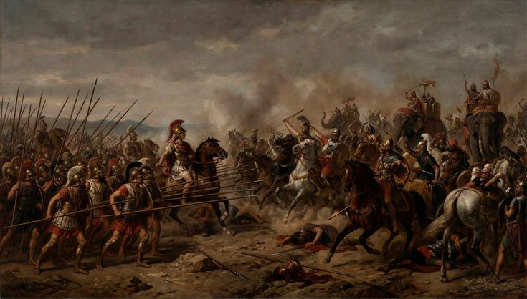
753 BCE
Rome is founded
The Roman Empire was one of the most powerful and influential civilizations in history. It began in 27 BCE when Augustus became the first emperor and expanded across Europe, North Africa,

Slide 4
509 BCE
Rome becomes a republic
The Roman Empire was one of the most powerful and influential civilizations in history. It began in 27 BCE when Augustus became

Slide 5

THE
THE RISE &FALL OF
ROMAN EMPIRE
NAPOLEON

Slide 6
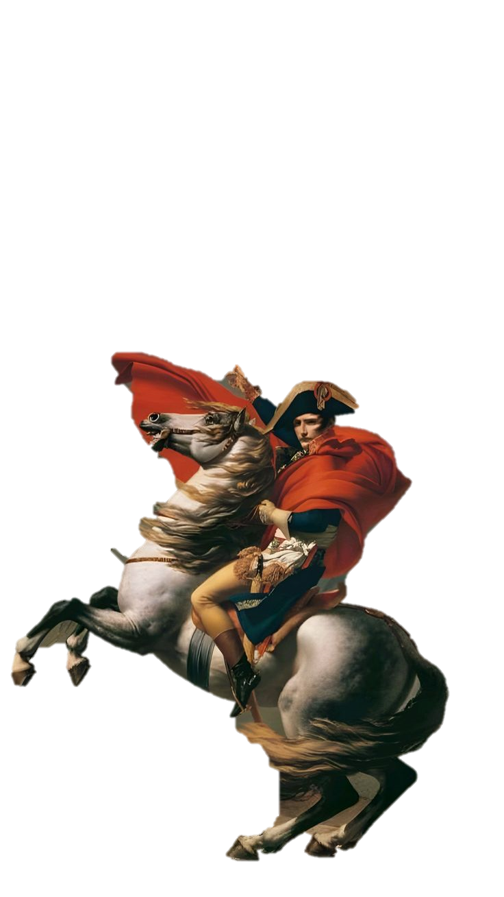
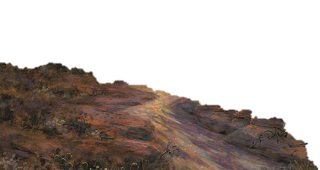
NAPOLEON
THE RISE &FALL OF
THE
ROMAN EMPIRE

Slide 7

THE
The Roman Empire was The Roman Empire was one of the most powerful and influential civilizations in history. It began in 27 BCE when Augustus North Africa,, and developed advanced systems of law and government that still influence the modern world. Latin was the main language, and Roman.
one of the most powerful and influential civilizations in history. It began in 27 BCE when Augustus became the first emperor and expanded across Europe, North Africa, and the Middle East. The Romans built strong roads, cities, and monuments, and developed advanced systems of law and government that still influence the modern world. Latin was the main language, and Roman.
ROMAN EMPIRE

